Slide 1
STUDENT NAME – Mark Jackson .J REGISTER NO – 711721243059 DEPARTMENT – B.Tech Artificial Intelligence and Data Science
3/21/2024 Annual Review

Slide 2
PROJECT TITLE : Real time object detection using CNN
3/21/2024 Annual Review

Slide 3


AGENDA
Problem Statement
Project Overview
End Users
Our solution and Proposition
Key Features
Modelling Approach
Results and Evaluation
Conclusion
3/21/2024 Annual Review

Slide 4

PROBLEM STATEMENT
To develop a real-time object detection system that can accurately identify multiple objects with images or video streams under various lighting conditions and complex backgrounds.
Optimizing the object detection algorithm for real time performance to meet the demands changing environments such as autonomous vehicles or when used in surveillance streams.
3/21/2024 Annual Review

Slide 5
PROJECT OVERVIEW
The Real time object detection Classification System aims to develop an efficient and accurate automated system for classifying objects based on various parameters.
A real-time object detection system using CNNs can be implemented in Autonomous Vehicles, Advanced Driver-Assistance Systems (ADAS), Smart Surveillance Systems, Industrial Automation and Robotic and in may other fields.
The real time object detections system will respond instantly to objects in videos, crucial for autonomous vehicles and safety systems, Gain a constant stream of information about surroundings, improving decision making in security and traffic management.
As we use CNNs it minimizes errors in object detection, leading to more reliable systems.
3/21/2024 Annual Review

Slide 6

WHO ARE THE END USERS?
.
Robotics engineers
Software developers
AR/VR developers
Drivers
Traffic authorities
Retail store managers
3/21/2024 Annual Review

Slide 7

YOUR SOLUTION AND ITS VALUE PROPOSITION
We proposed a solution in CNN Architecture trained on a dataset of labeled images containing with different variety of objects
Automated image analysis with Accurate object classification and assessment.
Uses a user-friendly framework that allows users to easily customize the object detection pipeline.
This model would be optimized for speed and accuracy while maintaining a small footprint for deployment on resource-constrained devices (e.g., mobile phones, embedded systems).
3/21/2024 Annual Review

Slide 8

THE WOW IN YOUR SOLUTION
Automated image analysis revolutionizes object classification.
Precision and speed ,Instantaneous, accurate assessment of different types of objects
Real-time object detection using CNNs empowers and enhances various aspects in different fields like Autonomous Systems, Advanced Safety Systems, Intelligent Surveillance, Smart Traffic Management.
This combination of ease of use, flexibility, and scalability makes the project stand out. It empowers developers to create intelligent and interactive applications with real-time object detection capabilities without the traditional complexities often associated with CNNs
3/21/2024 Annual Review

Slide 9
MODELLING
Convolutional Neural Networks (CNNs) for object Classification:
CNNs are ideal for image classification tasks like object classification due to their ability to automatically learn and extract hierarchical features from images.
Data Preprocessing for object Classification:
Image Loading: Load the different object images from the dataset, ensuring that they are properly labeled with their corresponding object type.
Resizing: Resize the images to a standard size (e.g., 224x224 pixels) suitable for CNN input while maintaining the aspect ratio.
Normalization: Normalize the pixel values of the images to a range between 0 and 1 to ensure uniformity and facilitate training convergence
Training Process for object Classification:
Model Architecture Selection: Choose a CNN architecture suitable for image classification tasks, such as ResNet, Inception, or EfficientNet.
Training: Train the CNN model on the training dataset using techniques like mini-batch stochastic gradient descent (SGD) or Adam optimizer.
Validation: Validate the model's performance on the validation set to monitor for overfitting.
3/21/2024 Annual Review

Slide 10
MODELLING
Model Training
Fine-tuning: If the pre-trained model doesn't perfectly align with your object detection needs, consider fine-tuning it on your own dataset. This involves:
Data Collection: Gather a dataset of images or video frames containing the objects you want to detect. Annotate the data with bounding boxes around each object and its corresponding class label.
Transfer Learning: Utilize the pre-trained model's weights as a starting point and retrain the final layers on your dataset. This leverages the model's learned features for generic object detection while adapting it to your specific objects.
.
Model Evaluation for object Classification:
Accuracy: Compute the classification accuracy of the trained model on the test set to measure its overall performance.
Precision, Recall, F1-Score: Calculate precision, recall, and F1-score for each class to assess the model's performance on individual object types.
Confusion Matrix: Generate a confusion matrix to visualize the model's performance in terms of true positive, false positive, true negative, and false negative predictions for each class.
3/21/2024 Annual Review

Slide 11
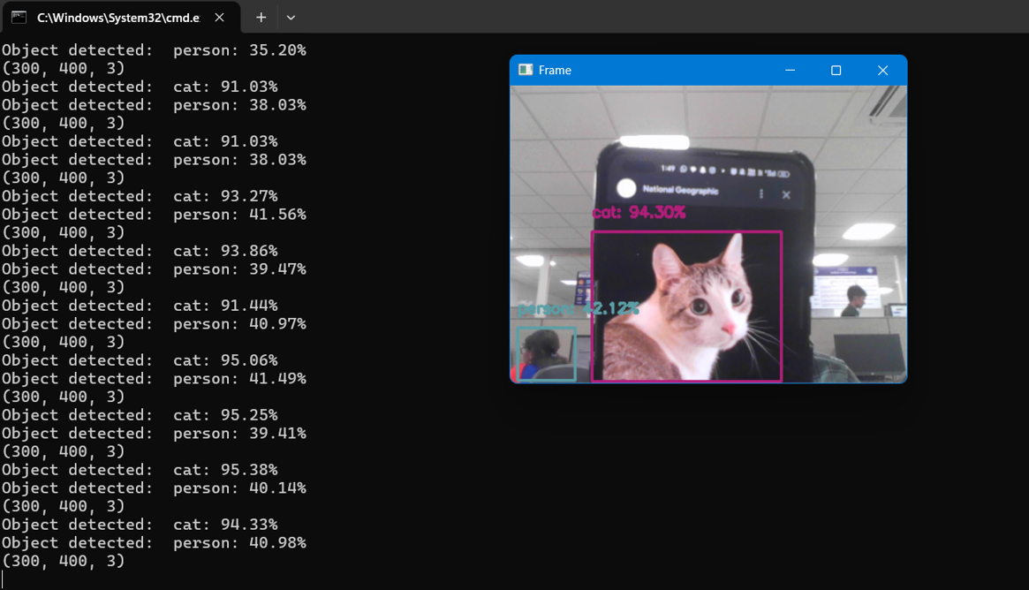
RESULTS
3/21/2024 Annual Review

Slide 12
Conclusion
Real-time object detection using CNNs unlocks a new level of intelligence and interaction with the surrounding world. Here's a concluding perspective:
Revolutionizing Applications: This technology empowers the development of advanced systems in fields like autonomous vehicles, robotics, and smart surveillance. It enables real-time decision making based on the immediate visual understanding of the environment.
A Scalable Future: The ability to adapt pre-trained models and the flexibility of deployment options (on-device or cloud) make this technology highly scalable. It can be integrated into diverse applications, from resource-constrained devices to powerful workstations.
In conclusion, real-time object detection with CNNs is not just about achieving high accuracy, but about empowering developers and transforming how systems and humans interact with the real world in real-time. It's a powerful tool with vast potential to shape the future of intelligent systems and applications.

